Slide 1



Software Engineering CS411, FALL 2025
Beta Testing and System Delivery. Risk Management by Prof. Mohamad Kassab,
Leonidas Kontothanassis kthanasi@bu.edu

Slide 2
agenda
Beta Testing
DRE METRIC
SPOILAGE METRIC
RISK MANAGEMENT
WIN-WIN ANALYSIS
TRACEABILITY TO MITIGATE RISKS

Slide 3

Beta testing is a type of software testing where a pre-release version of a product, like software or an application, is released to a select group of external users to gather feedback and identify potential issues or bugs before the final version is released to the general public. These external users, often referred to as beta testers or beta users, use the product in real-world conditions and environments.
Notes:
Google Maps Beta Testing crowdsourced the testing to a bunch of volunteers. In theory you get new maps features ahead of the

Slide 4
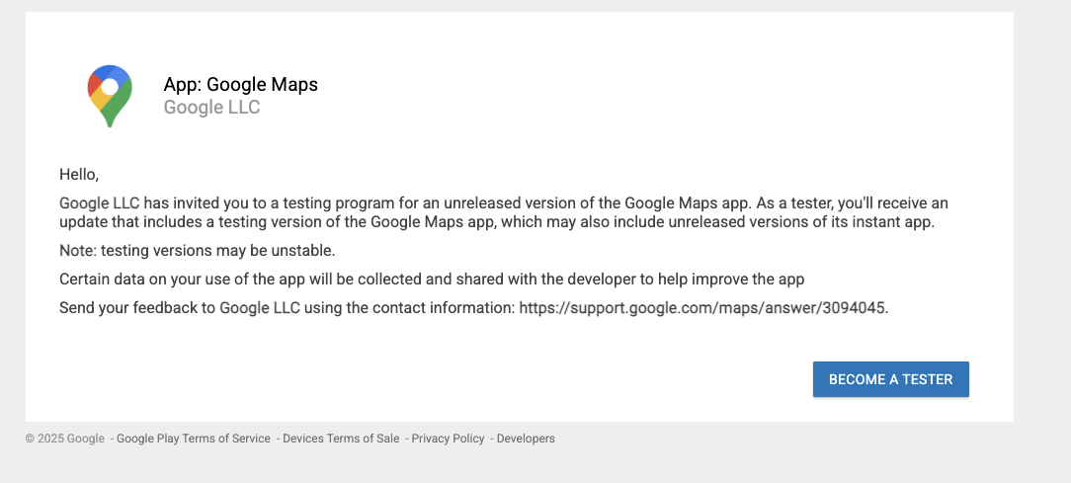
https://play.google.com/apps/testing/com.google.android.apps.maps
Notes:
Google Maps Beta Testing crowdsourced the testing to a bunch of volunteers. In theory you get new maps features ahead of the

Slide 5
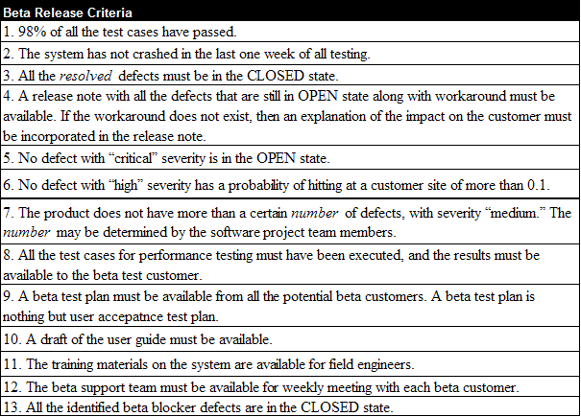
Beta Testing

Slide 6
Product Sustaining
Once the product is shipped to one of the paying customer the software project is moved to sustaining phase
The goal of this phase is to maintain the software quality throughout the product’s market life
Software maintenance activities occur because software testing cannot uncover all the defects in a large software system
The following three software maintenance activities were coined by Swanson:
Corrective: The process that includes isolation and correction of one or more defects in the software
Adaptive: The process that modifies the software to properly interface with a changing environment such as new version of hardware or third party software
Perfective: The process that improves the software by the addition of new functionalities, enhancements, and/or modifications to the existing functions

Slide 7
Product Sustaining
The first major task is to determine the type of maintenance task to be conducted when a defect report comes in from a customer
The sustaining team, which include developers and testers are assigned immediately to work on the defect
If the defect reported by the customer is considered as corrective in nature
The status of the progress is updated to the customer within 24 hours
The group continues to work until a patch with the fix is released to the customer
If the defect reported is considered as either adaptive or perfective in nature
it is entered in the requirement database, and it goes though the usual software development phases

Slide 8
Product Sustaining
The major tasks of sustaining test engineers are as follows:
Interact with customer to understand their real environment
Reproduce the issues observed by the customer in the laboratory environment
Once the root cause of the problem is known, develop new test cases to verify it
Develop upgrade/downgrade test cases from the old image to the new patch image
Participate in the code review process
Select a subset of regression tests from the existing pool of test cases to ensure that there is no side effect because of the fix
Execute the selected test cases
Review the release notes for correctness
Conduct experiments to evaluate test effectiveness

Slide 9
Measuring Test Effectiveness
Defect Removal Efficiency (DRE) metric defined as follows:

Slide 10
U. S. SOFTWARE QUALITY AVERAGES CIRCA 2008
(Defects per Function Point)
System Commercial Information Military Outsource
Software Software Software Software Software
Defect
Potentials 6.0 5.0 4.5 7.0 5.2
Defect
Removal 94% 90% 73% 96% 92%
Efficiency
Delivered
Defects 0.4 0.5 1.2 0.3 0.4
First Year
Discovery Rate 65% 70% 30% 75% 60%
First Year
Reported 0.26 0.35 0.36 0.23 0.30
Defects
Notes:
Defect Potentials: How many are there per function (on average) Removal Efficiency: How many are found by testing Delivered: How many make it production Discovery Rate: What fraction is discovered by customers Reports: Multiplication of last 2 metrics 1. System software = OS, compilers, device drivers etc. 2. Commercial Software = Apps running on top of system software (Office, Zoom, photoshop etc) 3. Information software = DBs, Visualization, Web 4. Military software = Missing guidance, battlefield comms, cybersecurity
5. Outsource = Catch all for not developed in-house.

Slide 11
U. S. SOFTWARE QUALITY AVERAGES CIRCA 2008
(Defects per Function Point)
Web Embedded SEI-CMM 3 SEI-CMM 1 Overall
Software Software Software Software Average
Defect
Potentials 4.0 5.5 3.0 5.5 5.1
Defect
Removal 72% 95% 95% 73% 86.7%
Efficiency
Delivered
Defects 1.1 0.3 0.15 1.5 0.68
First Year
Discovery Rate 95% 90% 60% 35% 64.4%
First Year
Reported 1.0 0.27 0.09 0.52 0.43
Defects

Slide 12
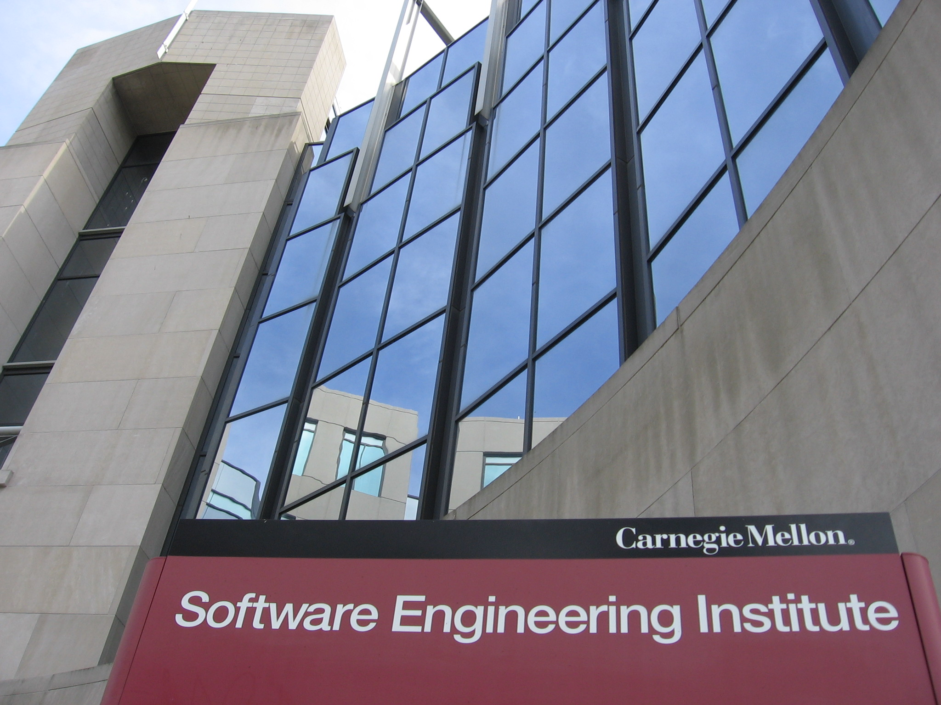
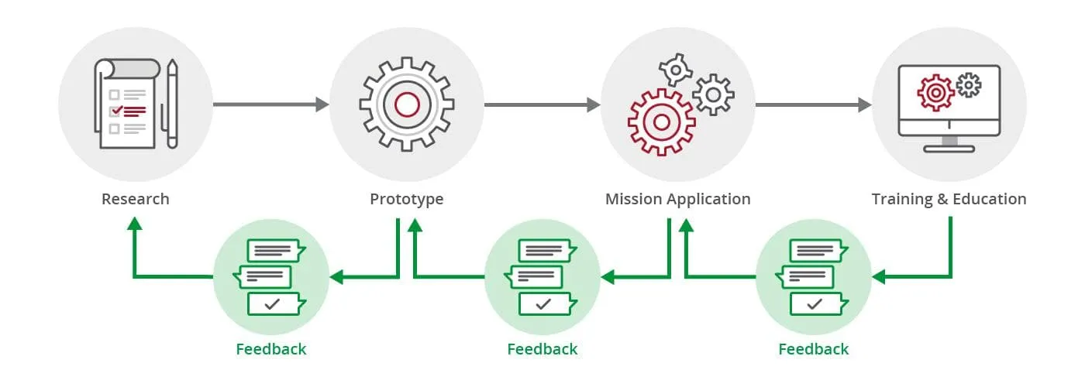
The Software Engineering Institute @CMU
Research on Software Engineering, cybersecurity, AI, and procurement in the interest of the Defense Establishment
https://www.sei.cmu.edu/our-work/
Creators of the CMM Model for Testing

Slide 13
SEI-CMM 1 to 5
 | State | Testing | Goal
SEI-CMM1 (Ad Hoc) | Chaotic/Inconsistent | Late in lifecycle, no formal process, accidental defect discovery, heroics | Make it work somehow
SEI-CMM2 (Repeatable) | Basic project management, some repeatable processes | Test planning, basic test cases, matching tests and requirements | Ensure testing is repeatable
SEI-CMM3 (Defined) | Process is standardized and documented | Formal test plan, detailed cases, peer review of tests, testing early in development | Testing is systematic and predictable
SEI-CMM4 (Managed) | Process is measured | All of level3 plus metrics collection and statistical analysis | Measured and data driven process
SEI-CMM5 (Optimized) | Continuous improvement | Prevent instead of detect defects | Continuous quality improvement
Notes:
SEI-CMM = Software Engineering Institute Capability Maturity Model
There are certified people who assign those scores but only useful if your customer cares.

Slide 14
INDUSTRY-WIDE DEFECT CAUSES
Ranked in order of effort required to fix the defects:
1. Requirements problems (omissions; changes, errors)
2. Design problems (omissions; changes; errors)
3. Interface problems between modules
4. Logic, branching, and structural problems
5. Memory allocation problems
6. Testing omissions and poor coverage
7.Test case errors
8. Stress/performance problems
9. Bad fixes/Regressions
10. Documentation errors

Slide 15
INDUSTRY-WIDE DEFECT CAUSES
Statistical analysis conducted by Lauesen and Vinter (for one project) reveals that out of 1000 defects:
23.9 % requirement issues
24.3 % functionality
20.9% component structure
9.6 % data
4.3 % implementation
5.2 % integration
0.9 % architecture
6.9 % testing
4.3 % others
Lauesen S, Vinter O (2001) Preventing requirement defects: An experiment in process improvement. Requirements Engineering 6(1):37–50
Notes:
Requirements = You misunderstood or the customer incorrectly specified what they wanted
Functionality = You did not implement what the customer wanted (mismatch between design and requirements)
Component structure = You did not clearly specify the data formats and APIs between modules
Data = Issues with data schema, data types, data corruption or missing data
Implementation = Lower level coding issues (dangling pointers, crashes, etc)
Integration = Similar to component structure but for external systems rather than internal ones
Architecture = Technology choices, software architecture, scaling limitations etc
Testing = Your tests are poor and do not catch problems, or worse flaky and show problems that aren’t really there

Slide 16
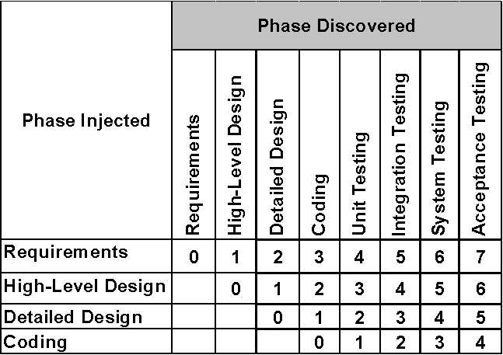
Spoilage Metric
Defects are injected and removed at different phases of a software development cycle
The cost of each defect injected in phase X and removed in phase Y increases with the increase in the distance between X and Y
An effective testing method would find defects earlier than a less effective testing method would
An useful measure of test effectiveness is defect age, called PhAge
Notes:
PhAge = Phase Age

Slide 17
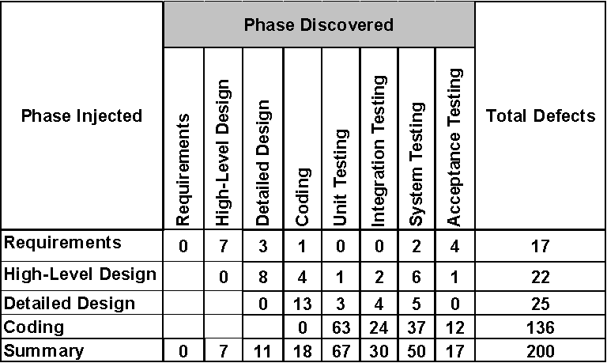
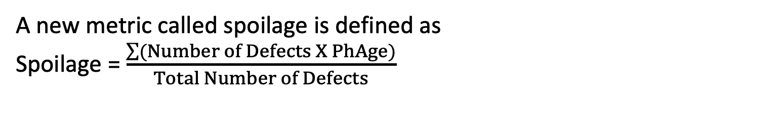
Spoilage Metric
A new metric called spoilage is defined as
Spoilage = $\frac{\sum{(Number of Defects X PhAge)}}{Total Number of Defects}$

Slide 18
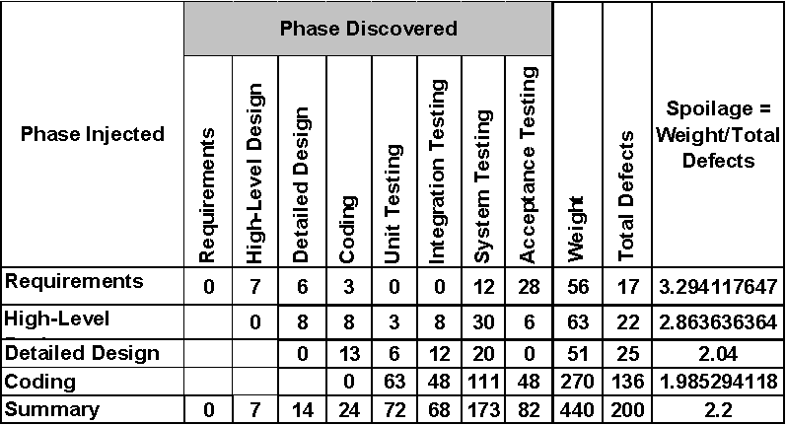
Spoilage Metric

Slide 19
Spoilage Metric
The spoilage value for the Boomerang test project is 2.2
A spoilage value close to 1 is an indication of a more effective defect discovery process
As an absolute value, the spoilage metric has little meaning
This metric is useful in measuring the long-term trend of test effectiveness in an organization

Slide 20

TEST YOUR KNOWLEDGE

Slide 21
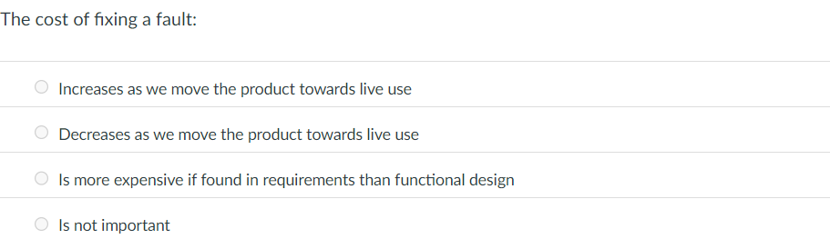

Slide 22
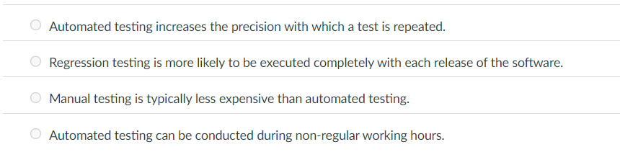
A software product is in its fourth release. The current testing process is completely manual. Senior engineers are assigned to test the new functionality of a release, and junior testers are assigned the task of manually conducting regression tests. Which of the following arguments do not support a case for automating the regression test cases?

Slide 23
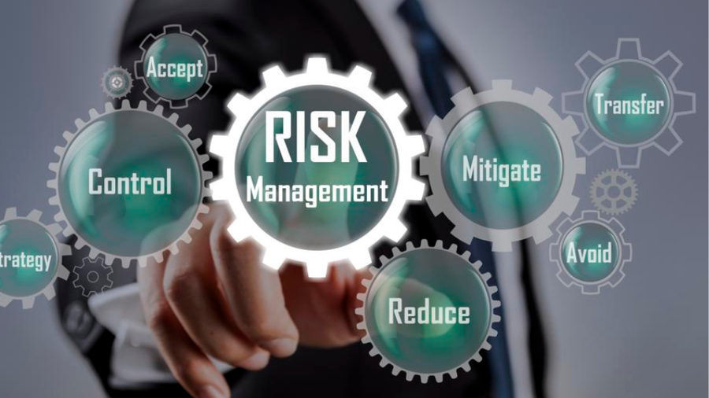

Slide 24
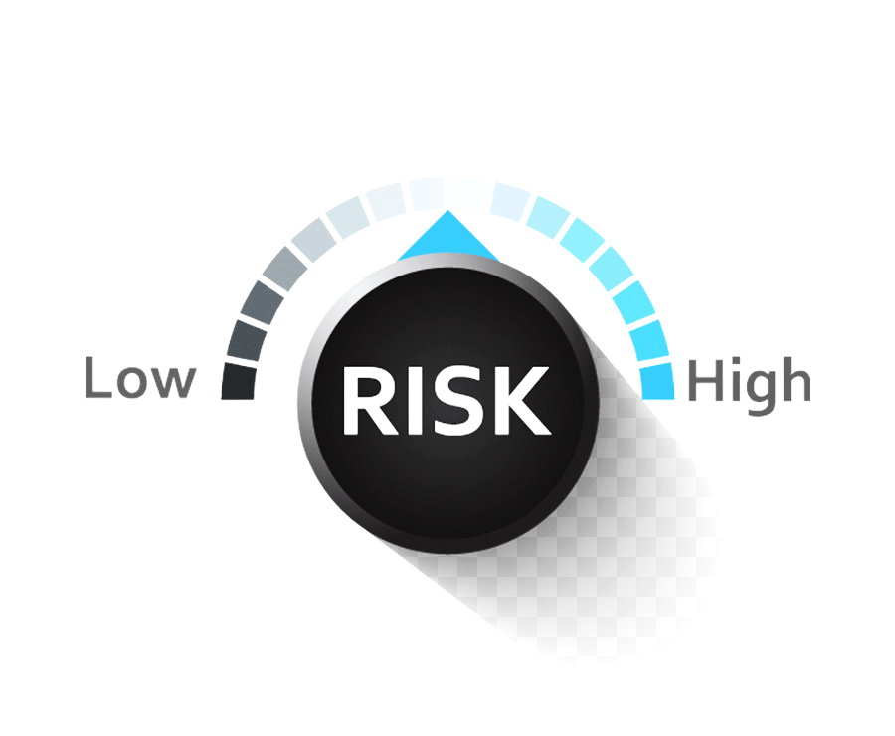
Risk Management
Risk management is concerned with identifying risks and drawing up plans to avoid/minimize their impact on a project.
You need to be able to anticipate risks, understand the impact of these risks on the project, and take steps to avoid these risks.

Slide 25
Risk Management
Risk management is important because of the inherent uncertainties in software development.
Where do uncertainties in software development stem from?
Notes:
These uncertainties stem from:
1- loosely defined requirements,
2- requirements changes due to changes in customer needs,
3- difficulties in estimating the time and resources required for software development,
4- differences in individual skills.

Slide 26

Risk Classification
There are two dimensions for risk classification:
The type of risk
The components affected by the risk
1) Project risks
Schedule or resources
2) Product risks
The quality or performance of the software being developed
3) Business risks
The organization developing or obtaining the software
Notes:
Project risks affect schedule or resources
Product (technical) risks affect the quality or performance of the software being developed
Business risks affect the organisation developing or procuring the software
Market Risk -> Competition
Strategic Risk -> Not aligned with the company
Sales Risk -> You can build it but not sell it
Management Risk -> Lack of coordination, change in scope, requirements etc
Budget Risk -> Costs more than expected

Slide 27
Examples of risks
Situation | Risk Class | Description
Staff turnover |  | Experienced staff will leave the project before it is finished.
Hardware unavailability |  | Hardware that is essential for the project will not be delivered on schedule.
Requirements change |  | There will be a larger number of changes to the requirements than anticipated.
Specification delays |  | Specifications of essential interfaces are not available on schedule.
Size underestimate |  | The size of the system has been underestimated.
Technology change |  | The underlying technology on which the system is/was built is superseded by new technology.
Product competition |  | A competitive product is marketed before the system is completed.
Project
Project
Project and Product
Project and Product
Project and Product
Business
Business

Slide 28
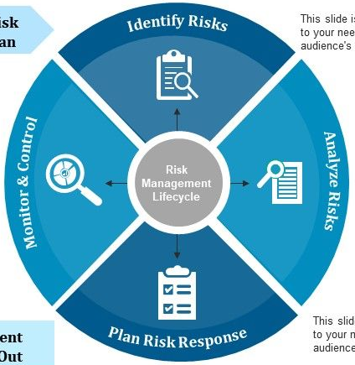
The risk management process
1. identify project, product and business risks
2. Assess the likelihood and consequences of these risks
4. Monitor and assess the risks throughout the project and update the plans for risk mitigation
3. Draw up plans to avoid / minimize the effects of the risk
Notes:
Risk identification
Identify project, product and business risks
Risk analysis
Assess the likelihood and consequences of these risks
Risk planning
Draw up plans to avoid or minimize the effects of the risk
Risk monitoring
You should regularly assess the risks and your plans for risk mitigation and update them when you learn more about the risks.

Slide 29

Affordability and win-win negotiation

Slide 30

What is“affordable”?
Affordable (dictionary.com)
adjective: that which can be afforded; believed to be within one's financial means.
Afford (Merriam-Webster)
verb: to manage to bear without serious detriment.
Many customers define “affordable” as “what I am willing to pay”!
my emphases
We are dealing with customer perceptions

Slide 31


Example 1: price gouging
You price a set of features at $1 million dollars.
The customer objects, so, you drop the price to $800K.
The implication here is that you were originally price gouging.
Alternative: offer a reduced feature set at $800K.

Slide 32
Risk matrix approach to affordability optimization
Requirement | Cost Estimate | Performance Metric(s) | Rank | Schedule | Risk Factor (5 high)
…
3.1.2 | 2.5K | Response time | high | .1 SM | 5
3.1.3 | 5K | Accuracy | medium | .3 SM | 3
…
Conduct tradeoff analysis based on some formulation of the above, …
BUT
What about dependencies to other requirements?
How do you quantify risk?
What kinds of risks?
What about internal consistency?
What about profitability?

Slide 33

Problem with understanding win conditions
I wish we had ….
 | Your Intuition Right | Your Intuition Wrong
Speak out | Small Loss | Large Gain
Remain silent | Small Gain | Large Loss
“Pascal’s Wager” consequence matrix for requirements communication

Slide 34
Other problems with customer win conditions
Conflicting client-vendor goals
Low client involvement
Conflicting requirements engineering approaches (between client and vendor)
Misalignment of client commitment with project goals
Disagreements in tool selection
Communication issues
Disowning responsibility
Sign –off issues
Tools misaligned with expectation
Jyoti M. Bhat, Mayank Gupta, and Santhosh N. Murthy, Overcoming “Requirements Engineering Challenges: Lessons from Offshore Outsourcing,” IEEE Software, September/October 2006, pp. 38-44.

Slide 35
Resolving client win conditions
Shared goal – that is, establish a project “metaphor”
Shared culture – in the project sense, not in the sociological sense
Shared process
Shared responsibility
Trust
From Bhat et al., 2006.

Slide 36
Win-win negotiating
Understand people’s expectations
Set the ground rules up front
Look for early successes
Be sure to give a little
Conclude negotiating only when all parties are satisfied

Slide 37
Example 2
Trade schedule for cost
Upon pressing the “launch missile button”, the system shall launch the missile within 40 ms.
Cost: $75K, 2 staff months
Alternative: Maintain cost but relax schedule to 4 months.

Slide 38
Example 3
Trade cost for risk
Upon pressing the “launch missile” button, the system shall launch the missile within 40 ms with 99% certainty.
Alternative: Recognize that hard schedulability guarantees are virtually impossible and expensive.

Slide 39
Example 4
Trade performance (accuracy) for cost
Upon pressing the “launch missile” button, the system shall launch the missile within 100 ms.
Alternative: Relax time to launch in order to meet schedulability constraints.

Slide 40

Traceability Help in Mitigating Risks

Slide 41

Traceability
Traceability is concerned with the relationships between requirements, their sources and the system design
Source traceability
Links from requirements to stakeholders who proposed these requirements
Requirements traceability
Links between dependent requirements
Design traceability
Links from the requirements to the design

Slide 42
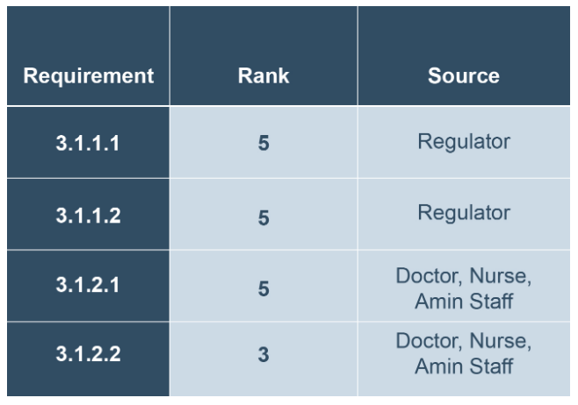

Slide 43
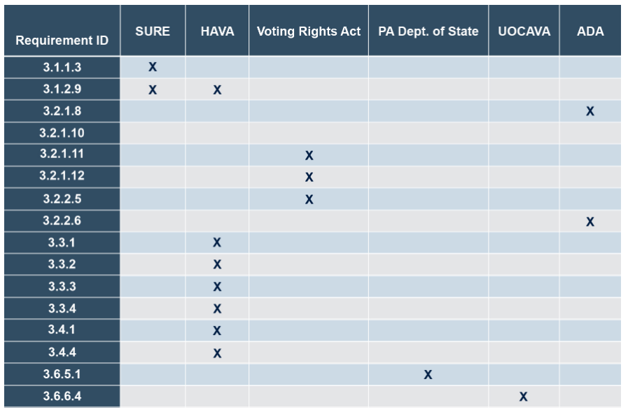

Slide 44
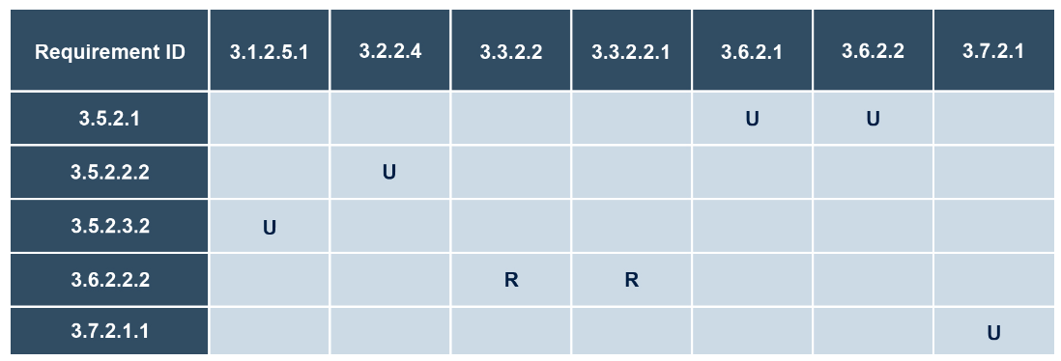
Notes:
Which requirements depend on other ones and whether the dependency has been reviewed/tested.

Slide 45
The Test Coverage Matrix
Ensures that requirements are listed.
Identifies the tests associated with each requirement.
Facilitates review of requirements and the tests.
Provides an easy mechanism to track status of test case design and review program.
Is easily made part of the master test plan and can be updated throughout the project to give a record of all requirements testing.

Slide 46
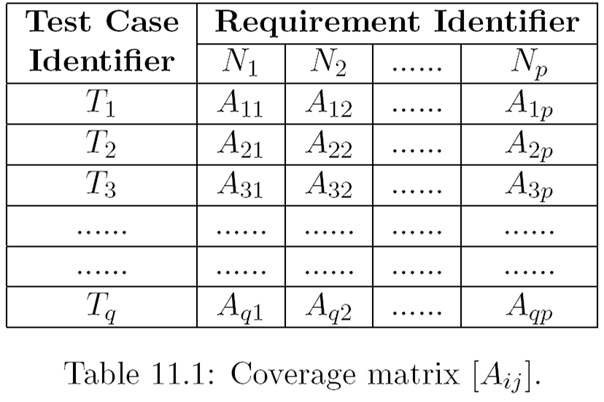
Test Coverage Matrix
T_{i} are test case numbers , N_{k} are requirements numbers from SRS. A_{ij}=X if test T_{i} tests requirement N_{j}

Slide 47
Test Coverage Matrix : Example
Requirement | Test Case #
 | 101 | 102 | 103 | 104
3.1. Provide the capability to submit the sales order for a single item. | X | X
3.2. Provide the capability to submit the sales order with multiple items and multiple quantities. |  | X | X | X
3.3. Generate an automatic back order for ordered items not in stock. | X |  |  | X
3.4. Generate an automatic customer credit verification for a new customer |  | X |  | X

Slide 48
Requirements Metrics
Requirement links to tests
Level 3 requirement linkage to tests
Level 4 requirement linkage to tests
Test span
Testing complexity
Notes:
Level 3 requirements = Verify functional and behavioral correctness (integration or system tests)
Level 4 requirements = Verify that individual pieces of logic perform as expected (unit tests)

Slide 49
Requirement Links to Tests
It is expected that each requirement will be linked to multiple tests.
Requirement 1
Test A
Requirement 2
Requirement 3
Test B
Requirement 4
Requirement 5

Slide 50
Test Span
Used to characterize the test plan and identify insufficient or excessive testing
Requirements per test
Tests per requirement
Research still ongoing to determine appropriate statistics. Look for inconsistencies.
But, there is always a trade off between time and cost of testing versus the comprehensiveness of testing.

Slide 51
Testing Complexity
Look at the number of requirements, the number linkages and the number of tests.

Slide 52
Testing Complexity
Build | Level | Ratio Links to Requirements | Ratio Links to Tests | Ratio Requirements to Tests
2 | 3 | 2 : 1 | 5 : 1 | 2.5 : 1
3 | 3 | 4 : 1 | 10 : 1 | 2.5 : 1
2 | 4 | 0.5 : 1 | 4.5 : 1 | 9 : 1
3 | 4 | 0.75 : 1 | 4 : 1 | 5.33 : 1
Notes:
A = L/R., B = L/T, B/A = (L/T) / (L/R) = R/T

Slide 53

NASA Requirements Taxonomy and Tracebility

Slide 54
NASA Requirements Taxonomy
Level 1
Mission level requirements
Very high level, rarely change
Level 2
High level with minimal change
Level 3
Derived requirements from level 2
Each level 2 requirement traces to one or more level 3 requirement
Contracts bid at this level of detail
Level 4
Detailed requirements
Used to design and code the system

Slide 55
Requirement Links to Tests : Level 3

Slide 56
Requirement linkage to Tests : Level 4

Slide 57


Readings , Assignments, Project Tasks
Read:
Chapter 28
Assignments & Project Tasks (Upcoming three items):
Assignment 3 is due tomorrow
Project Deliverable 4 is due in 2 weeks.

